Slide 1
Online Book Shopping
By:
Kiruthika S

Slide 2
Content
Introduction
Objectives
Requirements
Modules
Output
Conclusion

Slide 3
Introduction
The Purpose of this Online Book Shopping provides customers with online shopping facility through a web browser.
Using this project the user can purchase books instead of going out to a book store.
This project is to make a full functional online book store system that allow its users to search and purchase a book online based on category, author and subject.
A customer can create login to his account, sort books by their category, place books into a shopping cart and pay bill using his credit card details and also with some more payment options.

Slide 4
The admin has overall rights over the system and can moderate and delete any details from the shopping site.
He can add, delete and update the author, publisher, book categories, book details, member information and also confirm a placed order.
Online book Store is developed using HTML, CSS, Javascript programming language.

Slide 5
OBJECTIVES
The main objective of this Online Book Shopping System is to make manual system to computerized system.
This system will provide the customers to find their books in which they are willing to read, by search option and also can check the availability of a book either by using the book title or by using the name of author.
It simplifies the task and reduce the paper work.
AdditionalIy, unlike a store, online shopping has friendly customer service representatives available 24 hours a day also where customer can visit our site anytime to view the availability of books, choose any of them and can order by paying online or can opt for cash on delivery as well.
The administrator will regularly add any new books available to them for sale.

Slide 6
SOFTWARE INTERFACE
Operating System - Windows 7
HARDWARE INTERFACE
SERVER-: Processor – Intel Core Family,
RAM – 8 GB
Disk Space – 500 GB
TOOLS USED FOR PROJECT
Visual studio Code
WEB BROWSER
Chrome

Slide 7
Modules
Home page
User login
User registration
View Book Details
Place Order

Slide 8
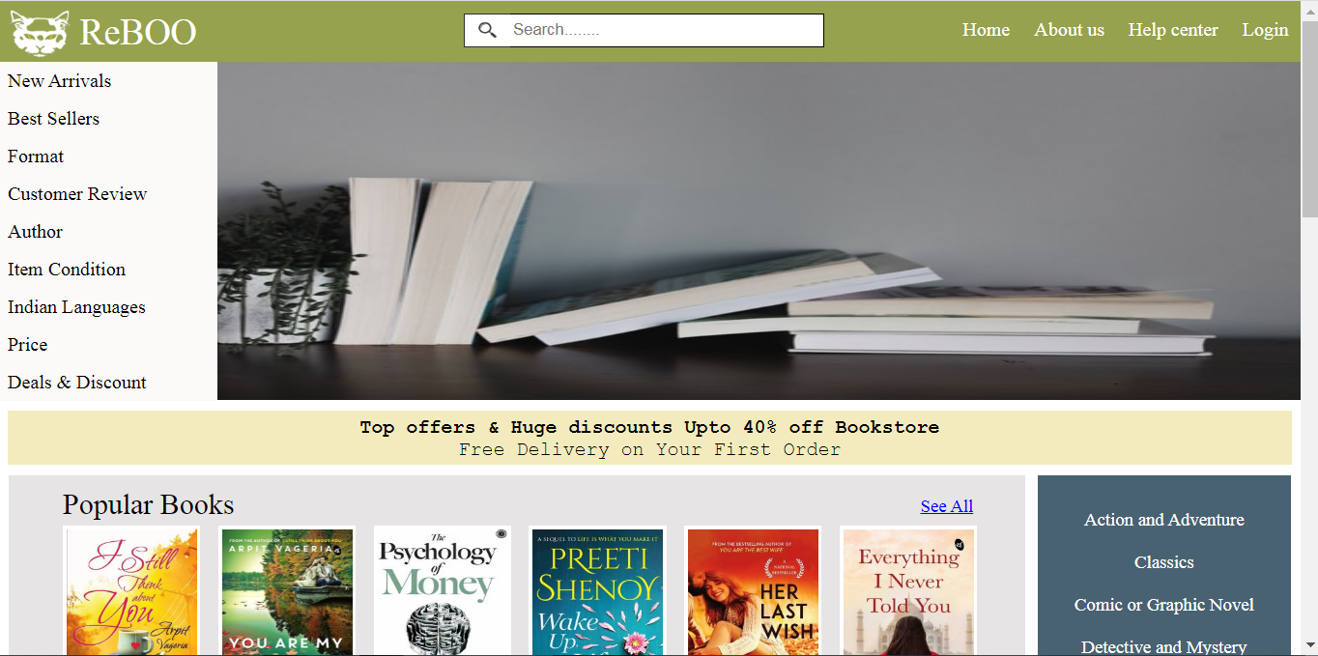
HOME PAGE

Slide 9
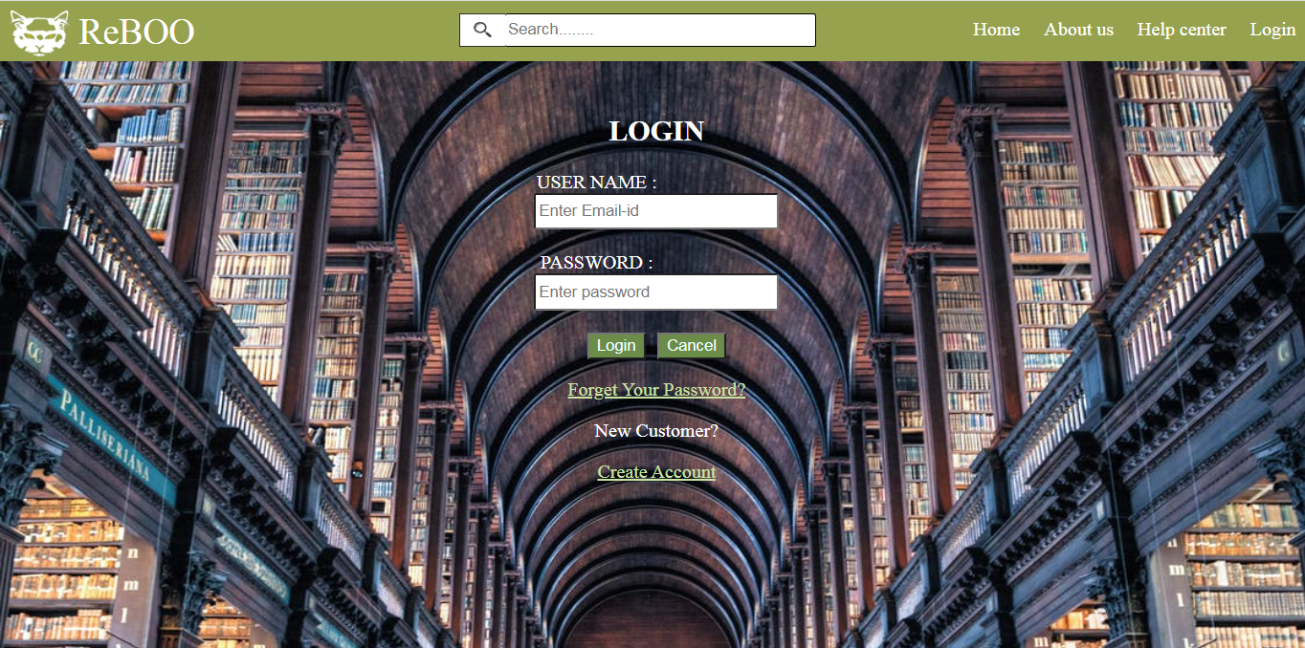
LOGIN PAGE

Slide 10
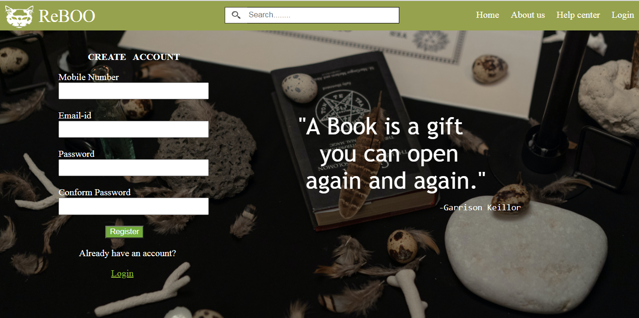
USER REGISTRATION PAGE

Slide 11
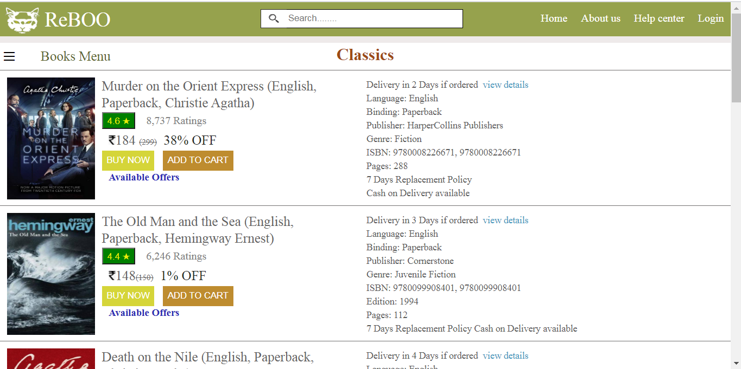
VIEW BOOK DETAILS PAGE

Slide 12
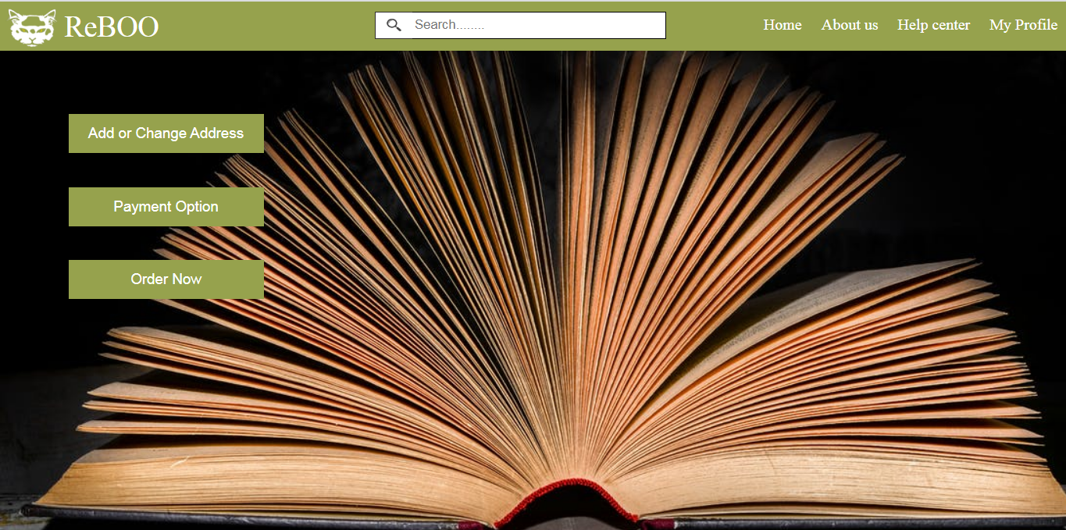
PLACE ORDER PAGE

Slide 13
Conclusion
Online Book Store is an online web application where the customer can purchase books online. The Customers can connect to the Internet through the computer or mobile phones into this online bookstore and then check the book information. Through a web browser the customers can search for a book by its title or author, later can add to the shopping cart and finally purchase the books. In future this project is expandable if we can include more modules to it, like shipping and door to door delivery tracking.

Slide 14
Thank You

